Slide 1
Analysis of vaccination rate and its effect on spread of Coronavirus
CSE3505 – Foundation of Data Analytics - F1
Advait Deochakke 20BCE1143 Aryan Shah 20BCE1490

Slide 2
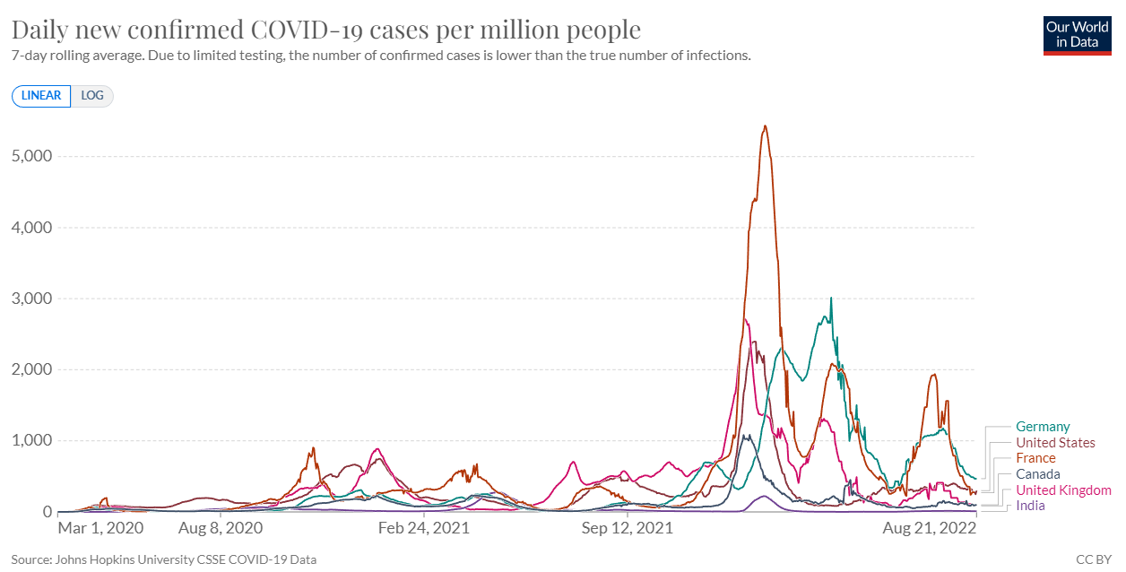
Introduction
Covid-19 gripped the world in early 2020 and extensive research was conducted. Vaccinations were soon prepared, like the Moderna or Pfizer vaccine. Many people jumped at the chance to get these vaccines, and millions of people were vaccinated every day.
Vaccine mandates, Mask mandates, and social distancing, combined with a prolonged period of social distancing and understanding from people has largely decreased infection rates.
Moreover, the pandemic has created a massive wealth of data due to the global-scale cooperation, creating opportunities for exercising various data analytics concepts.

Slide 3
Literature
https://onlinelibrary.wiley.com/doi/10.1002/jmv.27609 Correlation between vaccine coverage and the COVID-19 pandemic throughout the world: Based on real-world data Chao Huang,Lijun Yang,Jia Pan,Xiaomei Xu,Rong Peng - ‘mass COVID-19 vaccination policy would protect the health and wellbeing of all, especially when the rate of vaccination passes 60%’
https://doi.org/10.1016/j.msard.2022.104033 COVID-19 infection and vaccination against COVID-19 L. Pandit , A. Sudhir, C. Malli , A. D’Cunha - ‘vaccinations are safe and significantly mitigates the risk of severe infection’

Slide 4
Literature
https://doi.org/10.1016/j.meegid.2021.104834 Predictive analysis of COVID-19 eradication with vaccination in India, Brazil, and U.S.A Deepa Chaturvedi , U. Chakravarty ’we have predicted the possible timescales for the end of the epidemic for different values of vaccination rates’

Slide 5
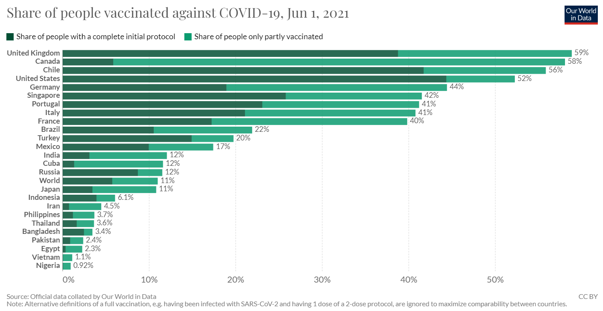
Problem Statement
Whether there is a connection between vaccination rates and infection rates
What is the extent of said connection, if it exists
Can we predict the decrease in infection rates as vaccination rates decrease?

Slide 6
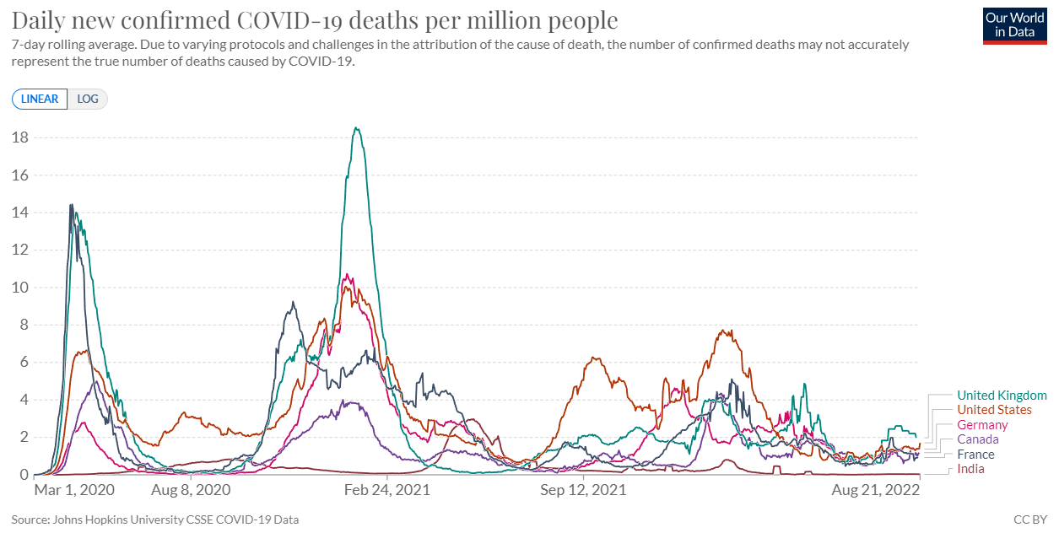
Problem Statement
Whether there is a notable relation between the two, to what extent they are interconnected, and how we can predict the rate of infection to change as time goes past and more people are vaccinated.
How does the spread of Coronavirus fare today?

Slide 7
Objective
Figuring out quantitatively whether the increasing rate of vaccinated individuals has had a definitive impact on the spread of novel coronavirus
If there is a notable relation between the two, to what extent they are interconnected
how we can predict the rate of infection to change as time goes past and more people are vaccinated

Slide 8
Dataset
https://ourworldindata.org/covid-vaccinations
Dataset maintained by John Hopkins Uni. and Oxford University.
Publicly and Grant funded online publication, maintained and developed ‘for the public good’, includes one of the world’s most complete data repositories, particularly for Coronavirus related data
Hannah Ritchie, Edouard Mathieu, Lucas Rodés-Guirao, Cameron Appel, Charlie Giattino, Esteban Ortiz-Ospina, Joe Hasell, Bobbie Macdonald, Diana Beltekian and Max Roser (2020) - "Coronavirus Pandemic (COVID-19)". Published online at OurWorldInData.org. Retrieved from: 'https://ourworldindata.org/coronavirus' [Online Resource]

Slide 9
Algorithms
Approach lies along the lines of co-relating vaccine rates by identifying weekly averages of increasing and cumulative vaccines (segregated by markers such as country, month, wave, etc – TBD) to the infection rate in that same category, and analyzing the processed data.
geom_smooth is used in the last few plot to highlight the trends and make them easier to see
it uses various models such as "lm", "glm", "gam", "loess"

Slide 10
Algorithm Description
Loess : Local Polynomial Regression Fitting Description
Fit a polynomial surface determined by one or more numerical predictors, using local fitting. uses a t-based approximation. The memory usage of this implementation of loess is roughly quadratic in the number of points, with 1000 points taking about 10Mb
glm : Fitting Generalized Linear Models Description
glm is used to fit generalized linear models, specified by giving a symbolic description of the linear predictor and a description of the error distribution.
A typical predictor has the form response ~ terms where response is the (numeric) response vector and terms is a series of terms which specifies a linear predictor for response. For binomial , the response can also be specified as a factor

Slide 11
lm : Fitting Linear Models Description
lm is used to fit linear models, including multivariate ones. It can be used to carry out regression, single stratum analysis of variance and analysis of covariance (although aov may provide a more convenient interface for these).

Slide 12
Implementation Result
R Code:
https://github.com/Advait177013/FDA_JComp

Slide 13
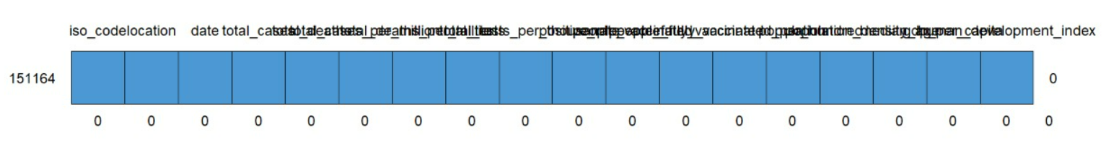
Graphical Analysis
md.pattern(min_full_set_by_country) after imputation process
> imputation process is hybrid of "complete case" analysis due to the non-random nature of data, and fill-based imputation of the "updown" method where possible (notable variables affected total deaths, total cases, full vaccines, population, and median age)

Slide 14
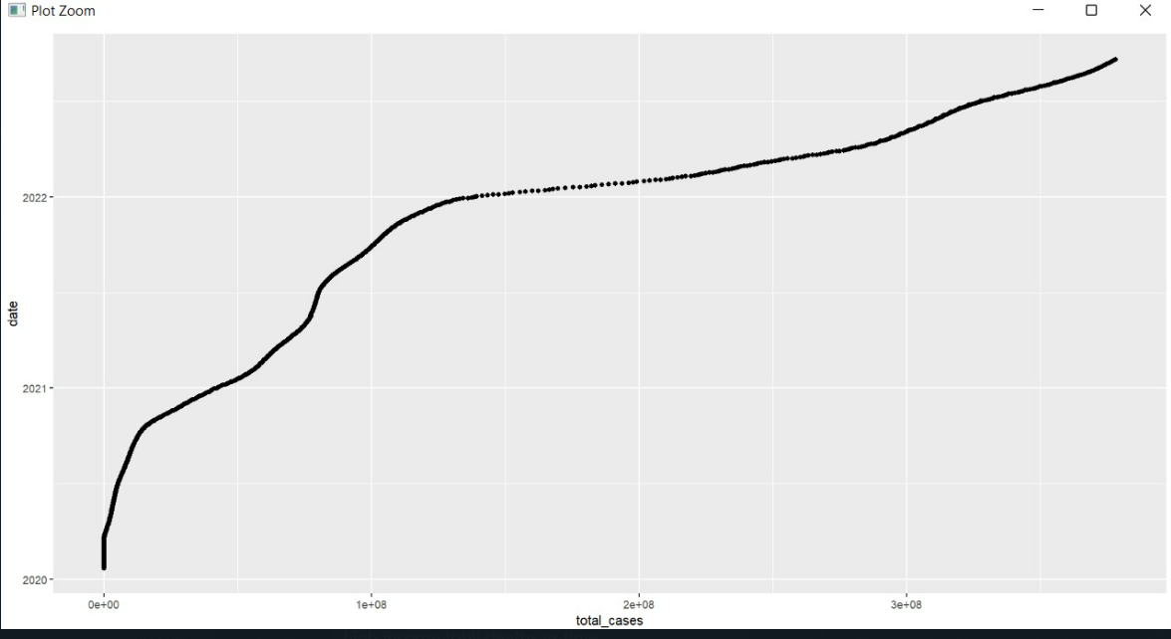
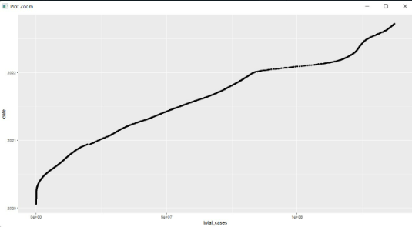
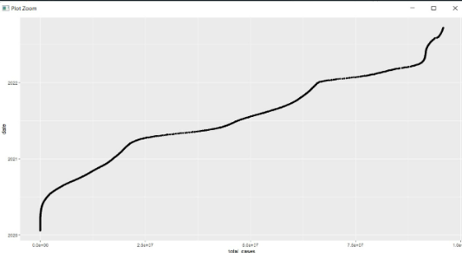
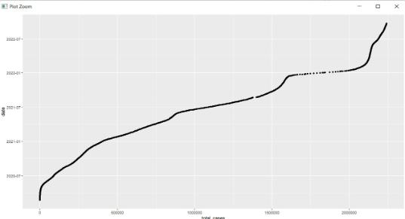
Plotting Cases vs Time
Left to Right, Up to Down → High Income, Upper middle, Low middle, Low

Slide 15
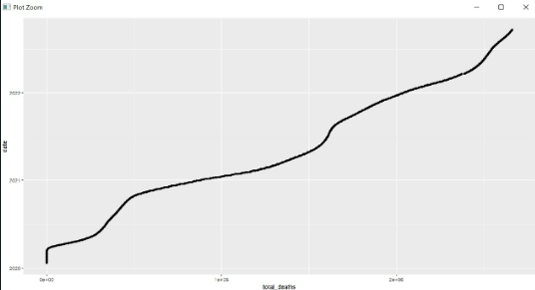
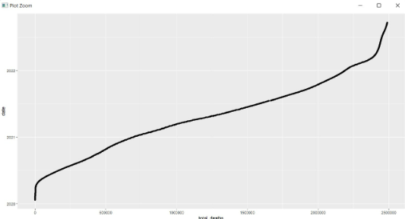
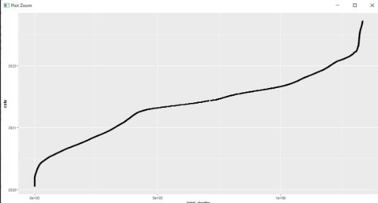
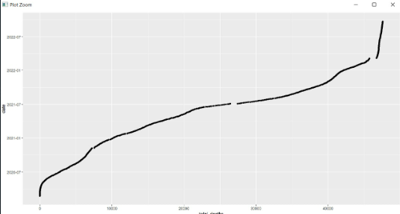
Plotting Death vs Time
Left to Right, Up to Down → High Income, Upper middle, Low middle, Low

Slide 16
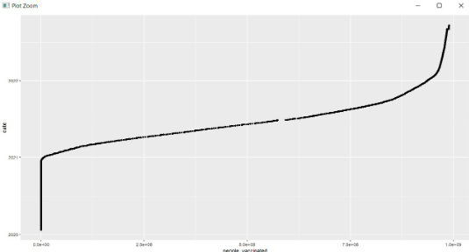
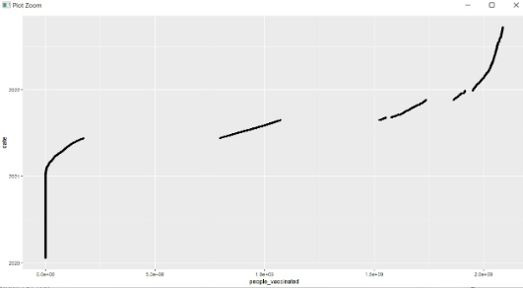
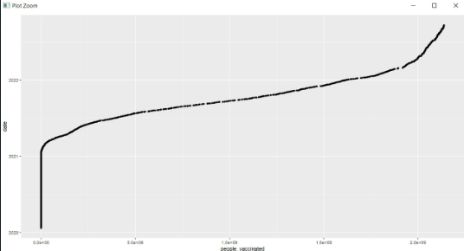
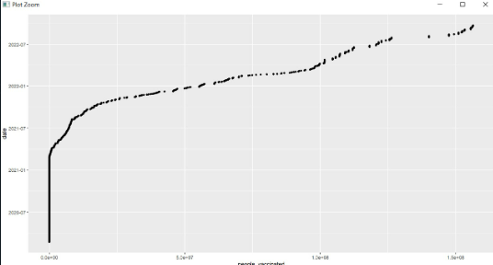
Plotting Vaccinated vs Time
Left to Right, Up to Down → High Income, Upper middle, Low middle, Low

Slide 17
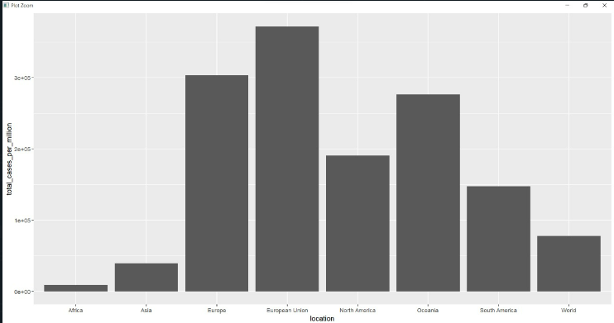
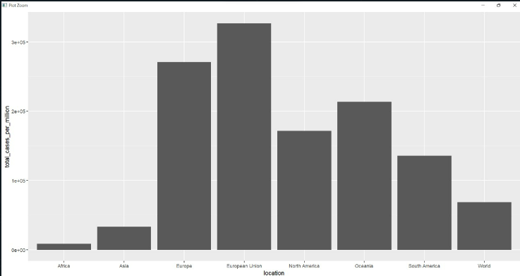
Cases per million, x=Regions
September’22 June ‘22

Slide 18
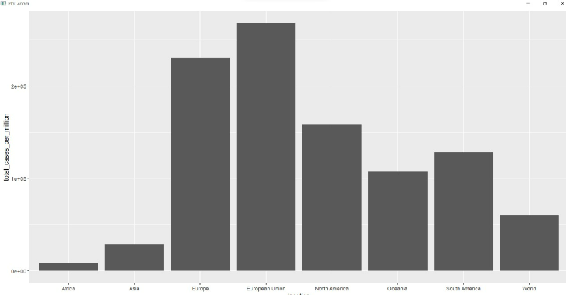
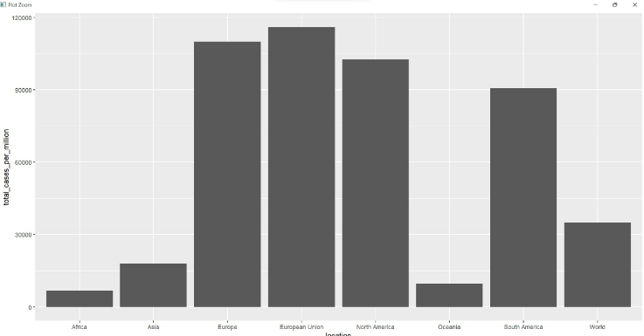
Cases per million, x=Regions
March’22 December’21

Slide 19
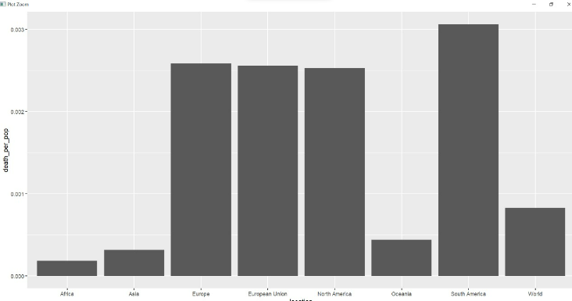
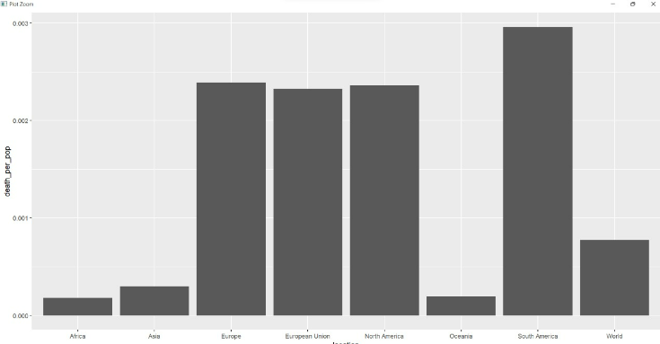
Deaths per million, x=Regions
Late September’22 Late march’22

Slide 20
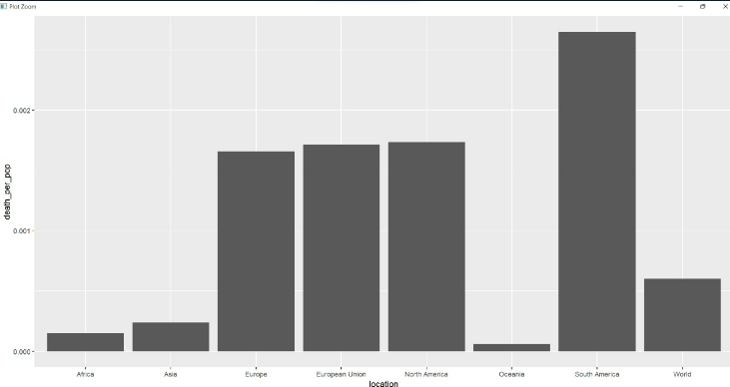
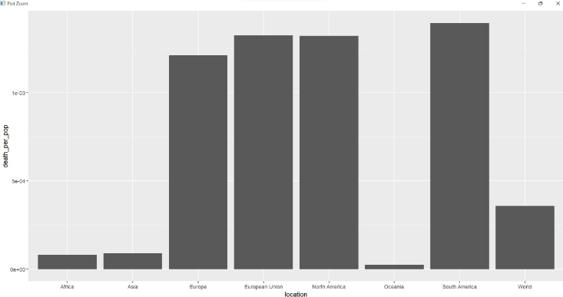
Deaths per million, x=Regions
Late September’21 Late march’21

Slide 21
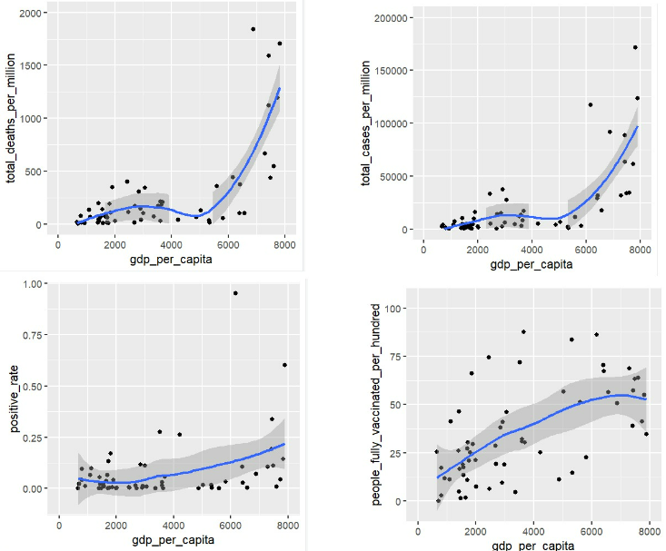
Graphs for sep ‘22, x=gdp(ppp) per capita

Slide 22
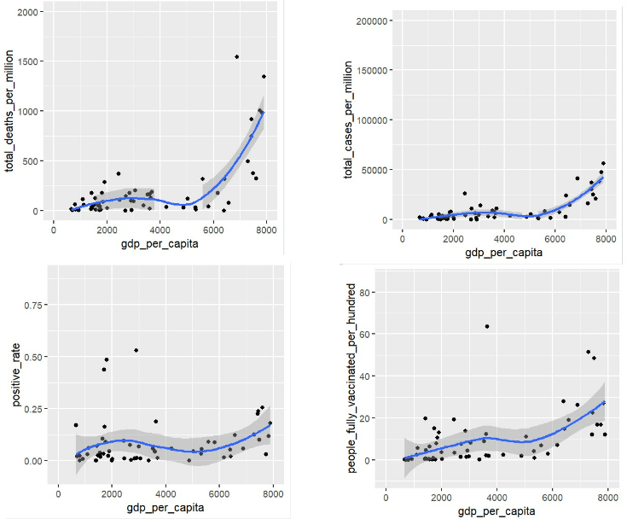
Graphs for sep ‘21, x=gdp(ppp) per capita

Slide 23
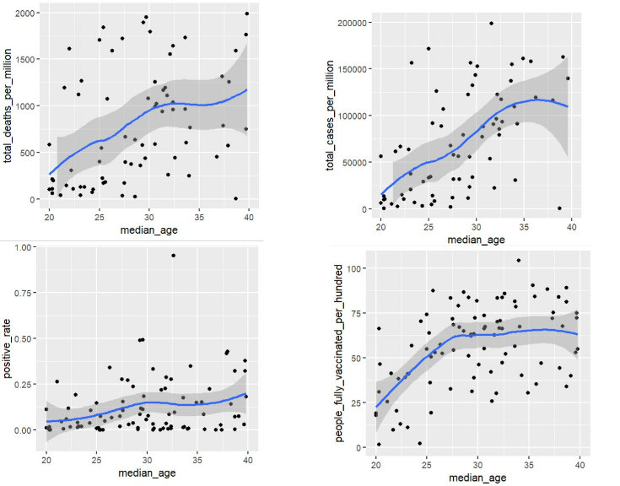
Graphs for sep ‘22, x = median age

Slide 24
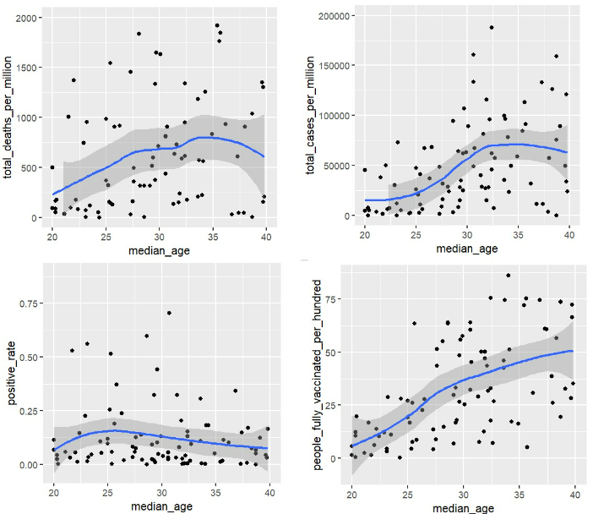
Graphs for sep ‘21, x = median age

Slide 25
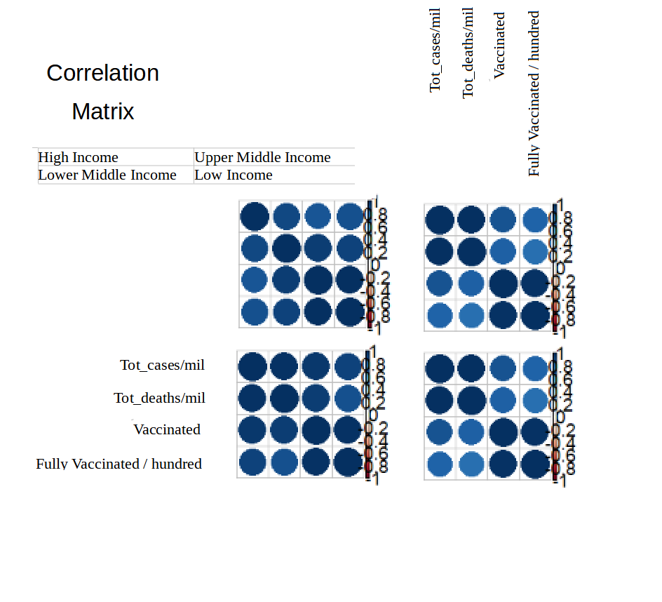
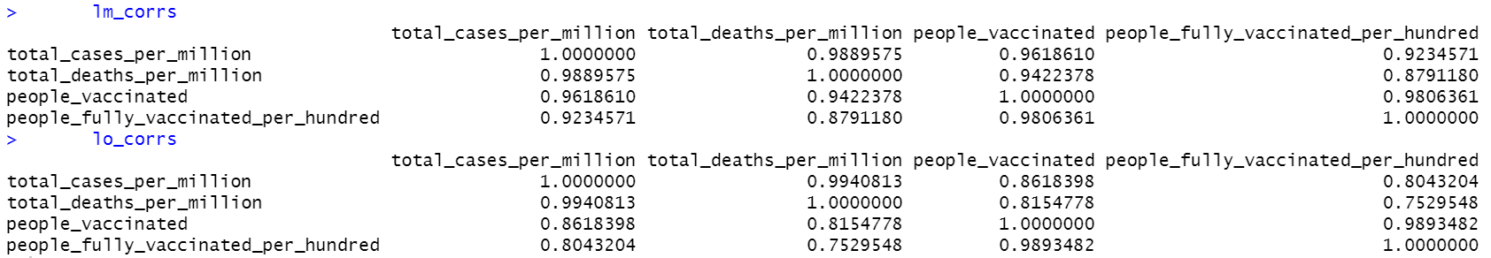
Correlation Matrix for Income Groups

Slide 26
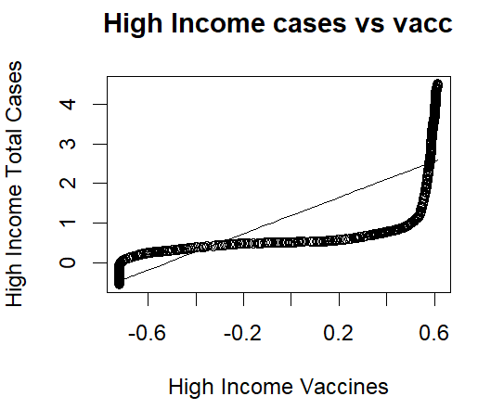
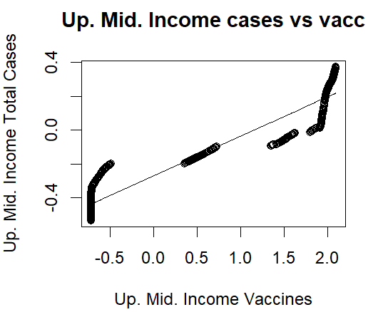
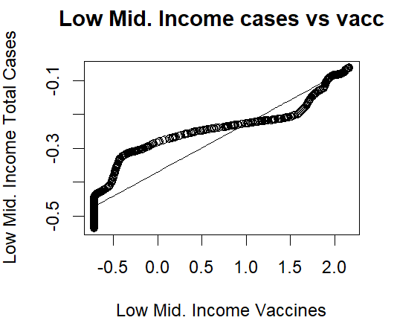
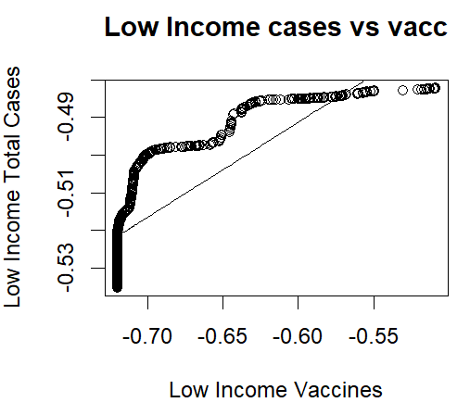
Predicted vs Real values – Cases vs Vacc
glm gauss

Slide 27
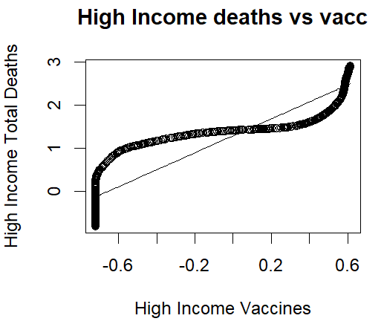
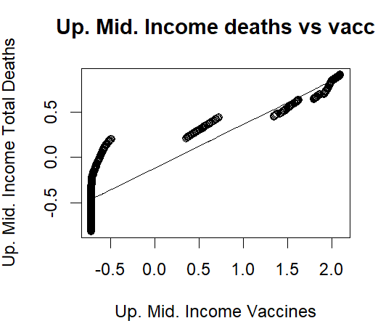
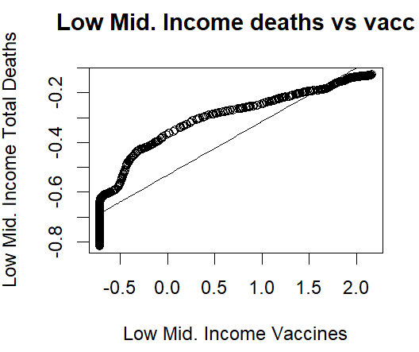
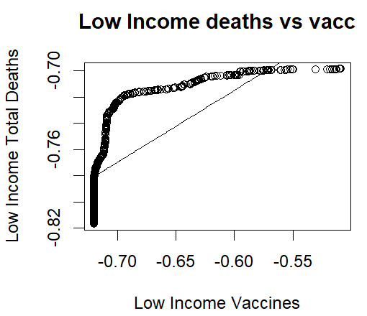
Predicted vs Real values – Deaths vs Vacc
glm gauss

Slide 28
Novelty of Findings
Offers a new look on the statistic of disease and infection rate, looking not from the perspective of mask users or social distancing norms followers, but foraying into vaccinations
Going past the immunity provided by vaccination and employing the considerations that ‘higher vaccination rates may indicate higher awareness and respectability of regulations’, and co-relating them with spreading rate of the virus

Slide 29
Conclusion
We may confirm the existence of a relation between vaccination rates in a particular demographic, and their relation of the spread of COVID-19 in the same demographic.
We may find to what degree this relationship is, and hope to investigate into whether this is causation type of relationship between the former and the latter, or a co-relation type.

Slide 30
Thank You -Advait Deochakke -Aryan Shah (References are inline)

